Slide 1
Swarm Intelligence Based Maze Solver​
069/BEX​
Digya Acharya​
Pranish Bhagat​
Pratik Bhandari​
Sijan Bhattarai​

Slide 2
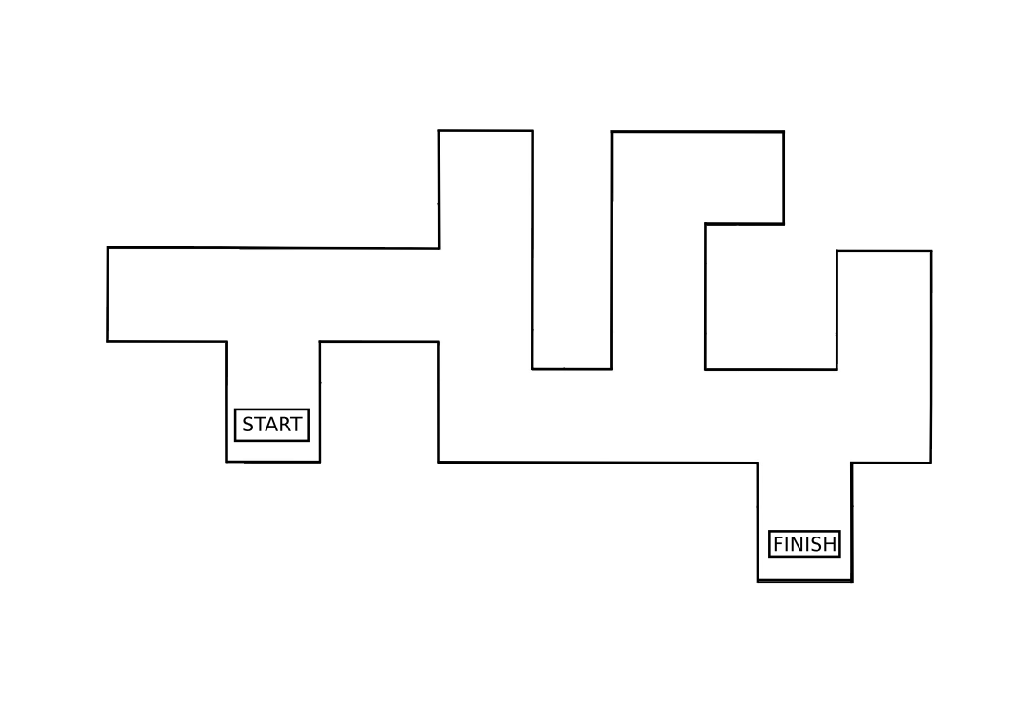
Can you guess the shortest path?

Slide 3






Slide 4
MAZE
TARGET
SWARM
WIRELESS
INTELLIGENCE

Slide 5
Why?
Efficient use of resource
Autonomous navigation
Work Division
De-centralization
Unknown terrain navigation
Notes:
Best possible us of resouce

Slide 6
Swarm
Design of group of robots that operate without any form of centralized control
Using local methods of control and communication
Local control – autonomous operation
Local communication – avoids bottlenecks
Scalable – new robots can be added, or fail without need for recalibration
Simplicity – cheap, expendable robots
Self-organization

Slide 7
Methodology

Slide 8
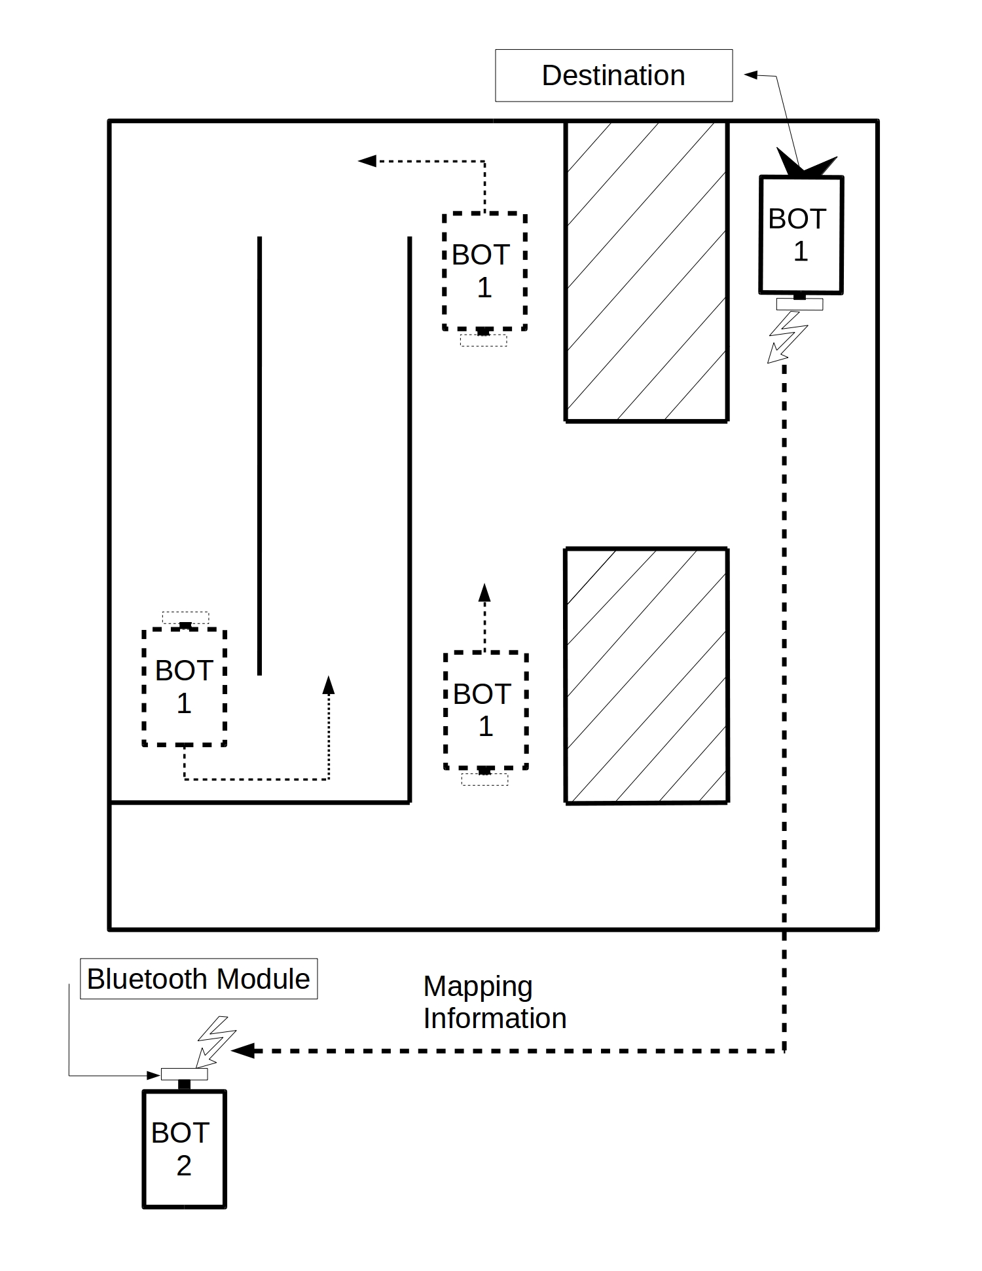
First Robot
Traverse with mistakes
Relay suitable information
Second Robot
- Traverse in shortest possible
path
System Architecture

Slide 9
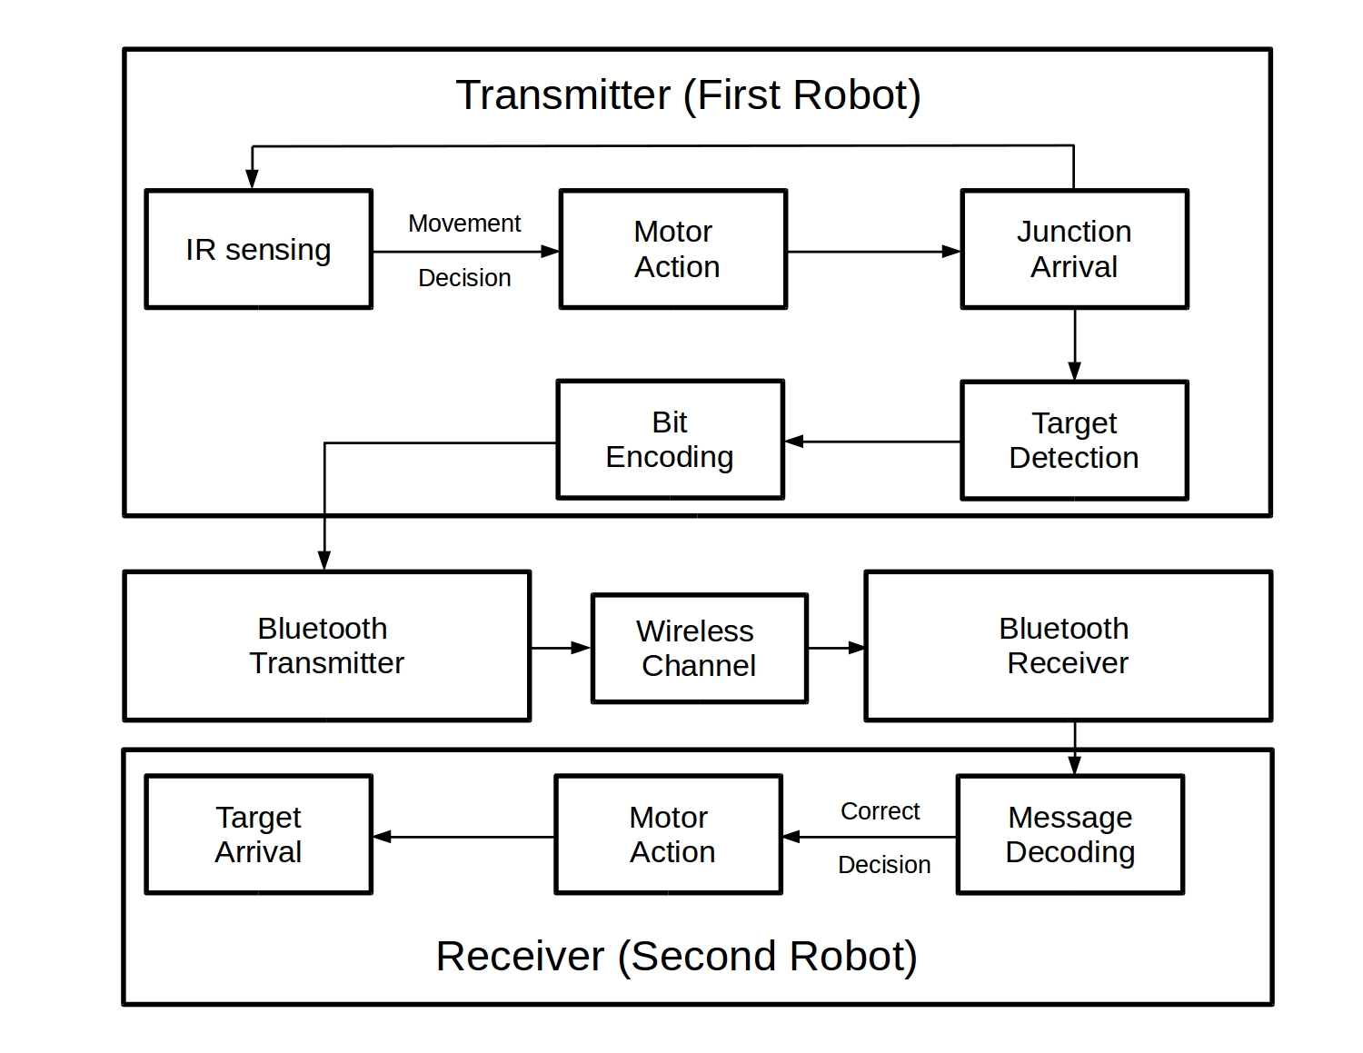

Slide 10
Functional Overview

Slide 11
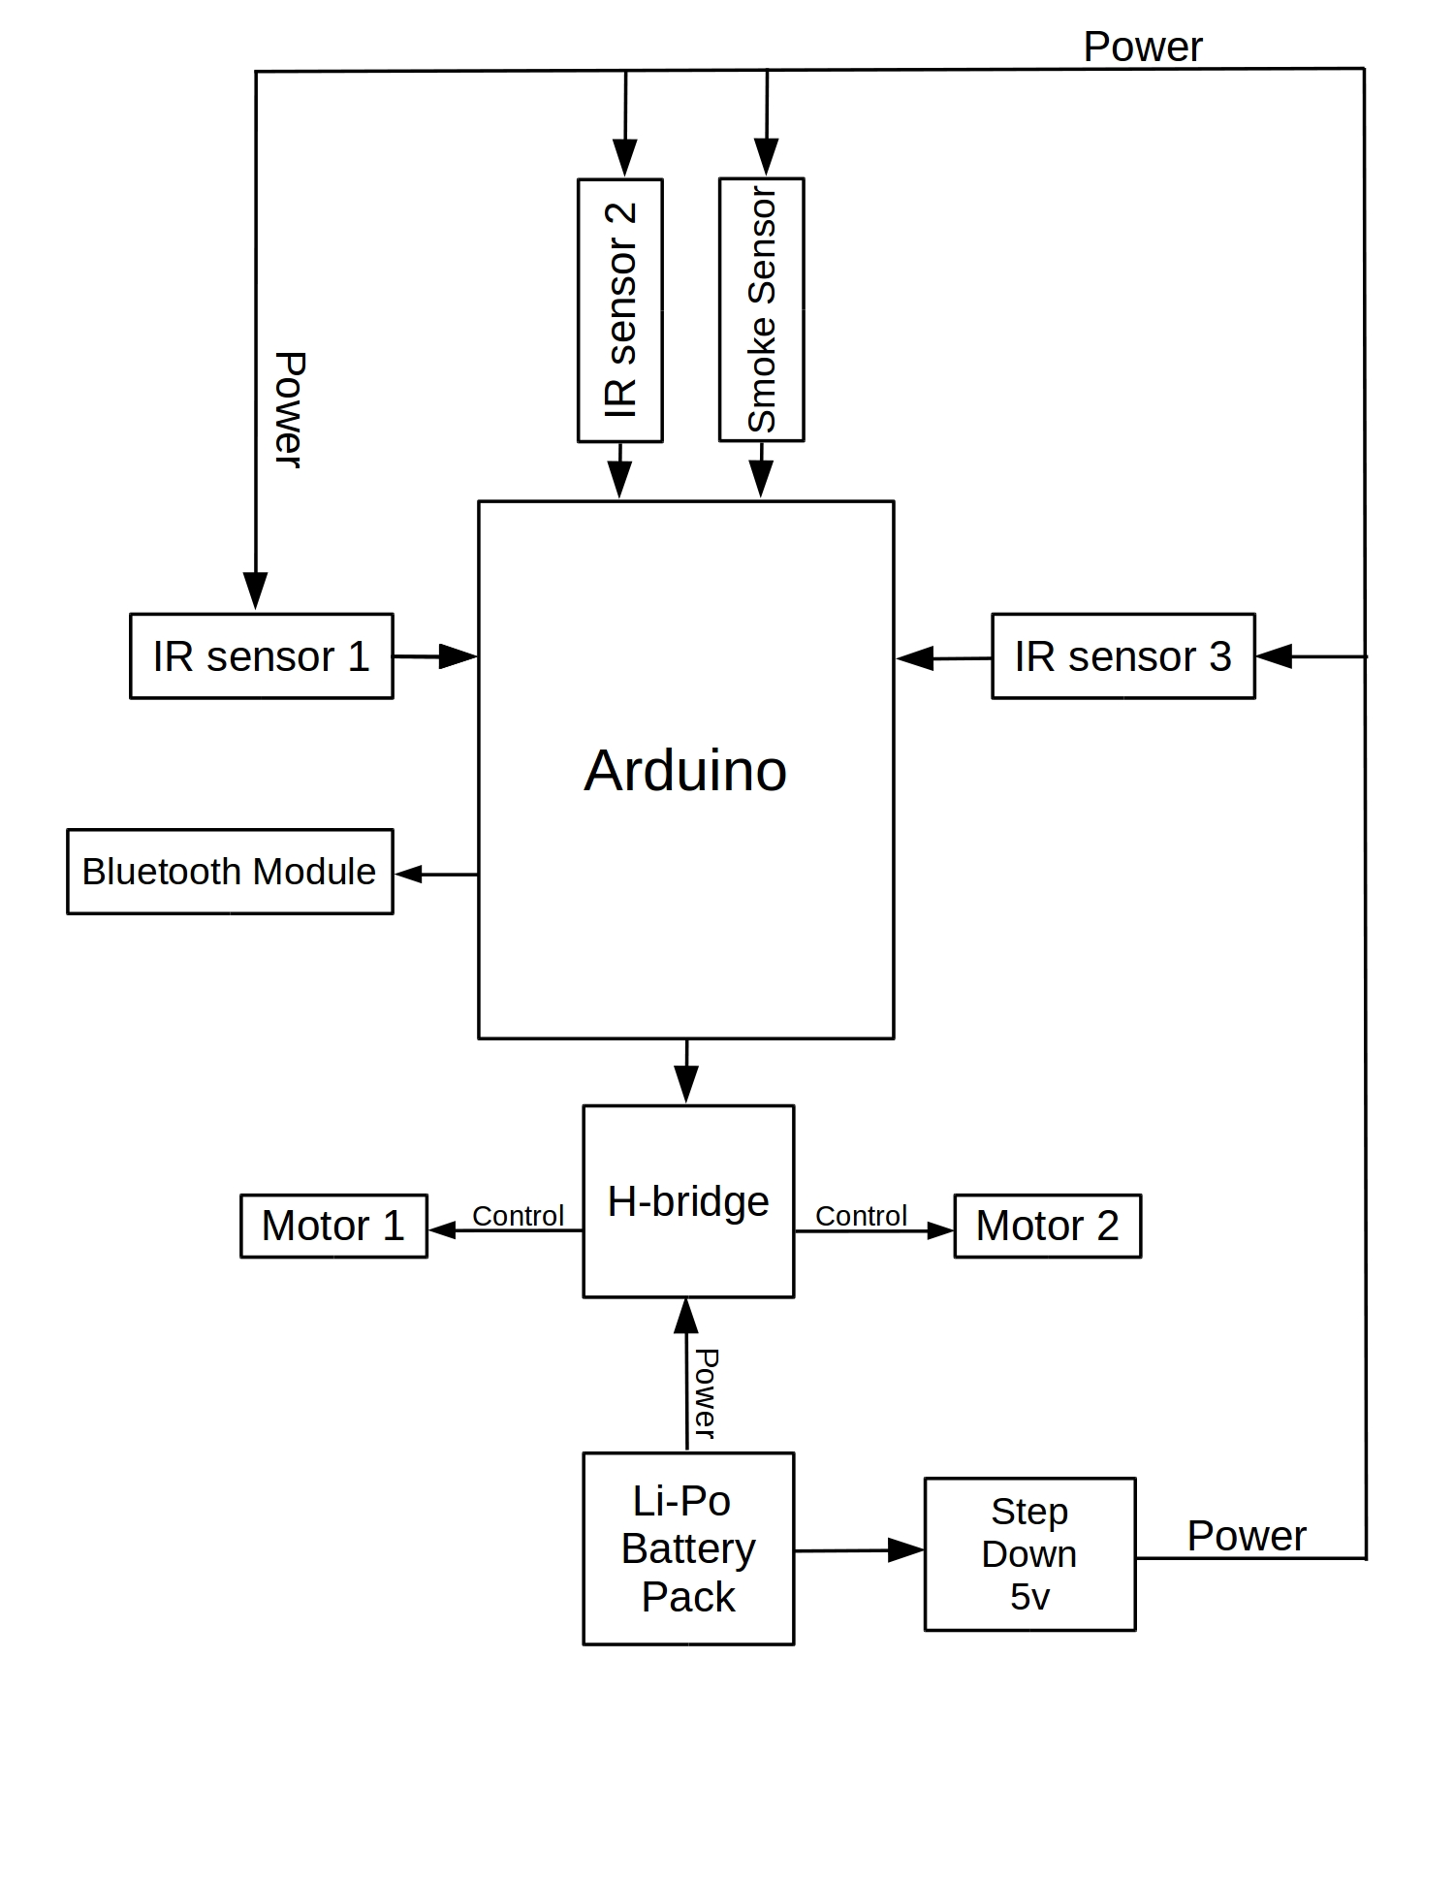
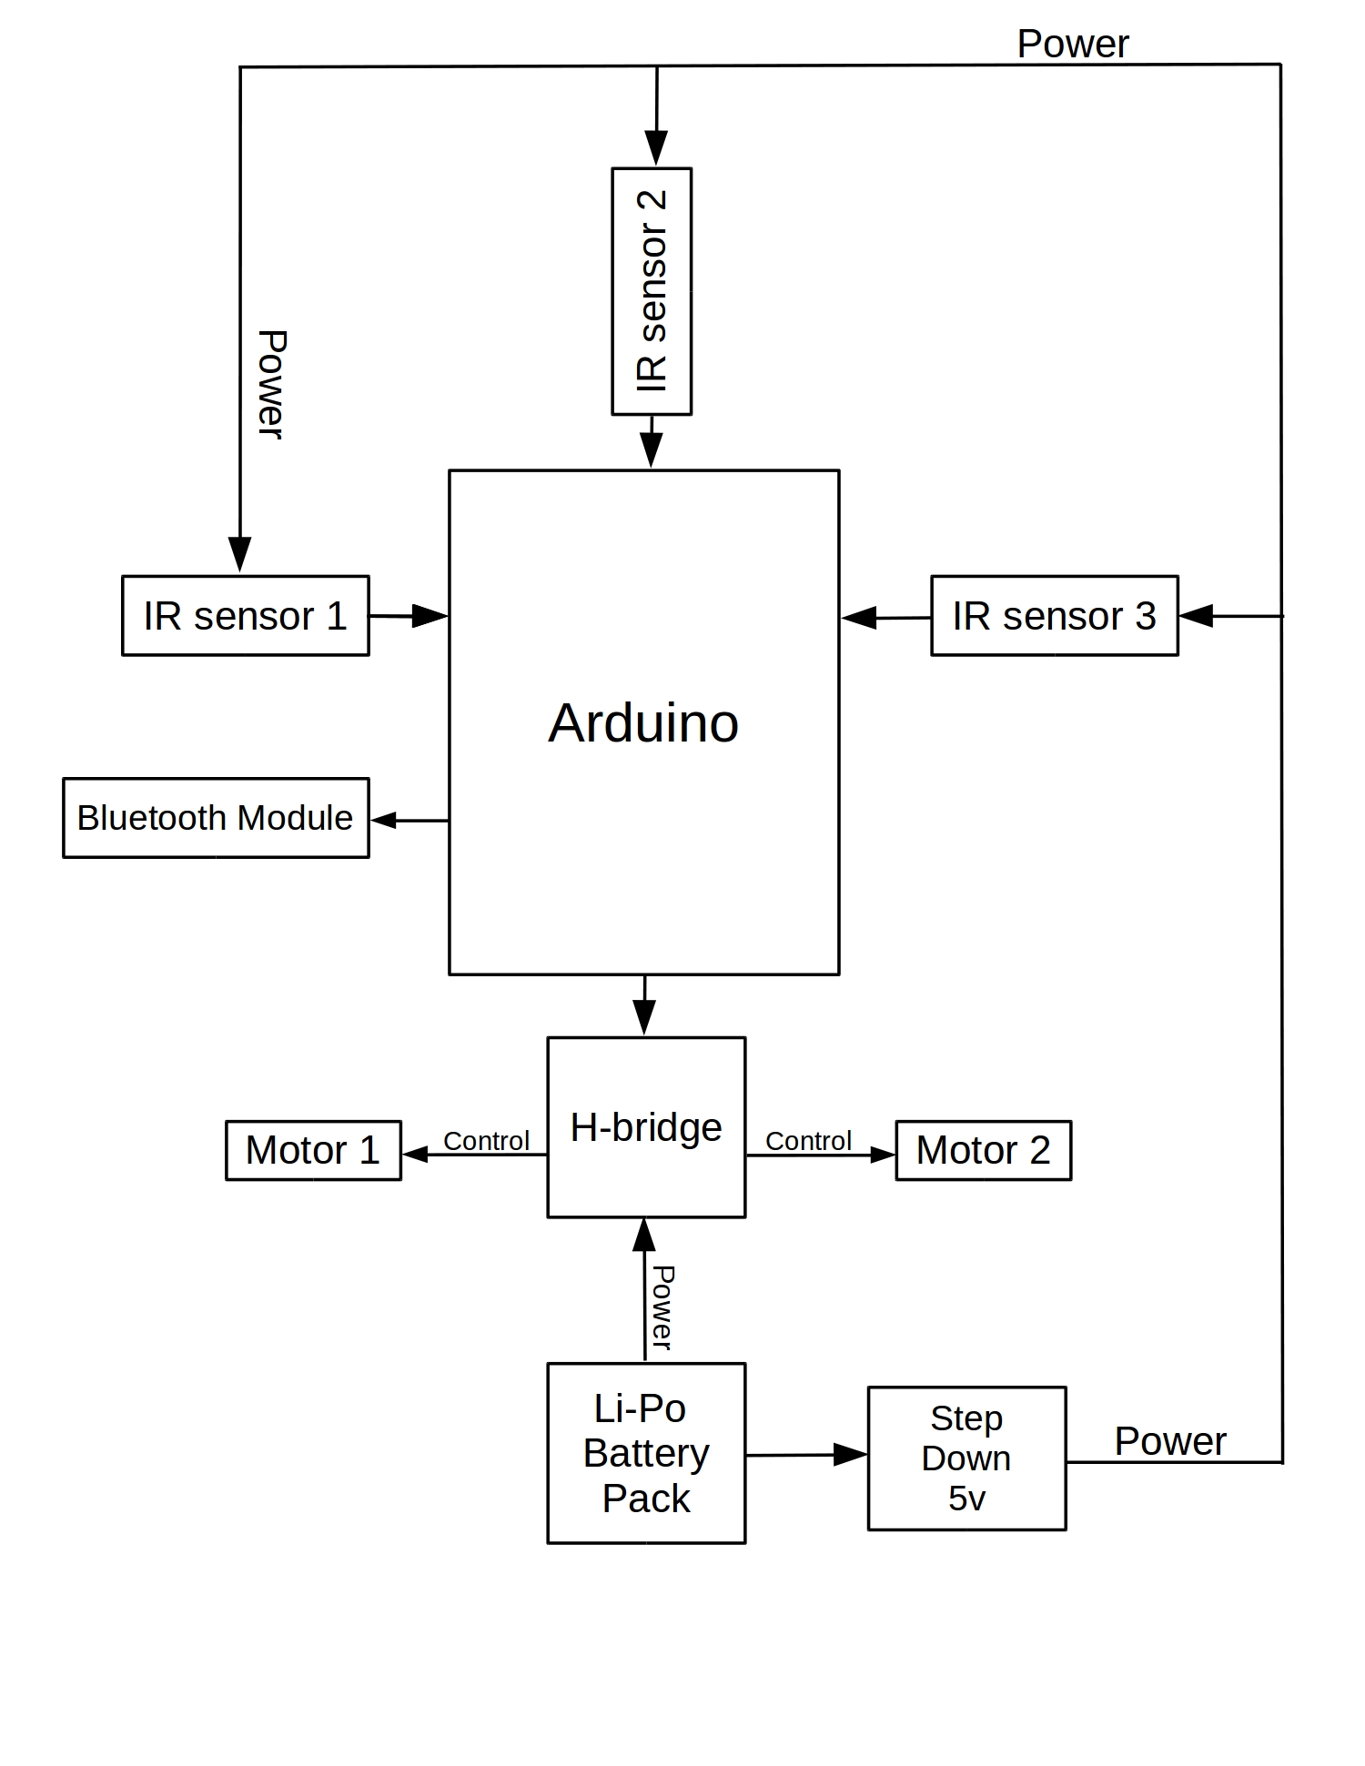
R O B O T S C H E M A T I C
First Robot
Second Robot

Slide 12
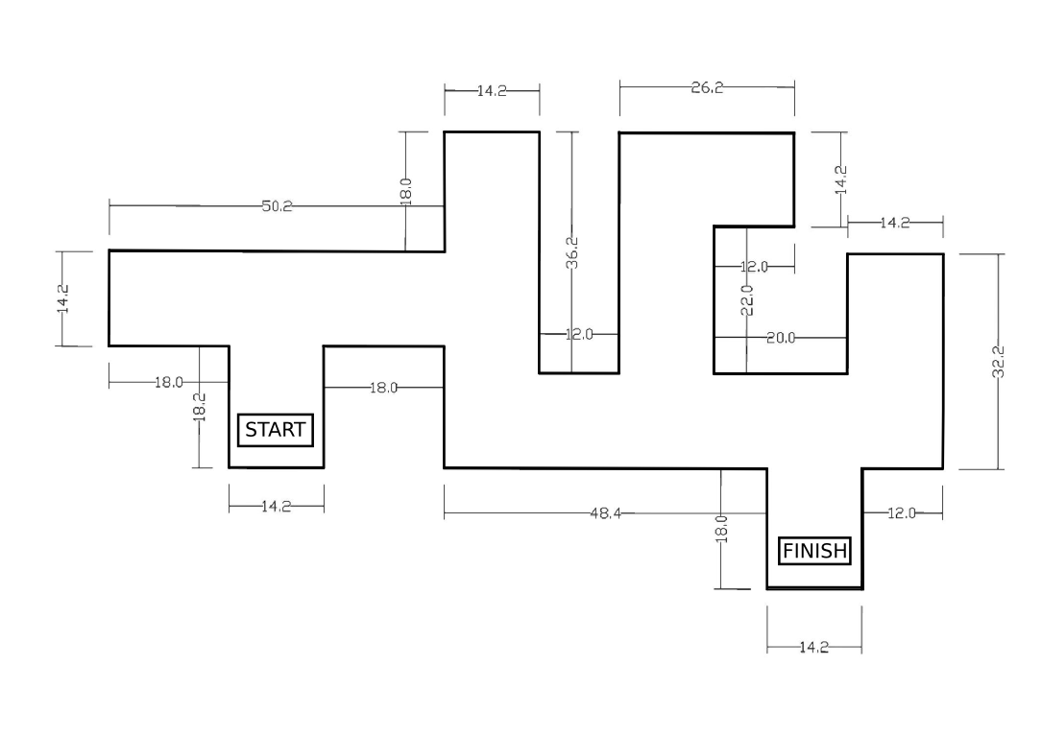
MAZE

Slide 13
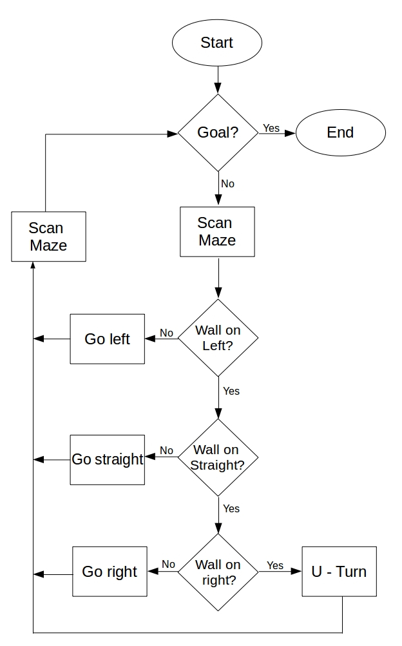
Left Wall Following Algorithm
Robot will reach the target by keeping track of the left wall
Priorities
Left
Straight
Right

Slide 14
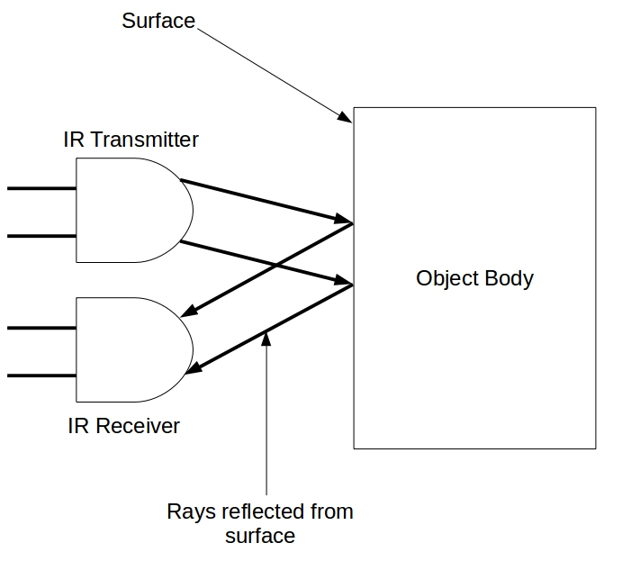
Obstacle Detection
IR Sensors
IR Transmitter
IR Receiver

